Slide 1
Descriptive Analysis of Student loan default
By Chiti Nkhuwa

Slide 2
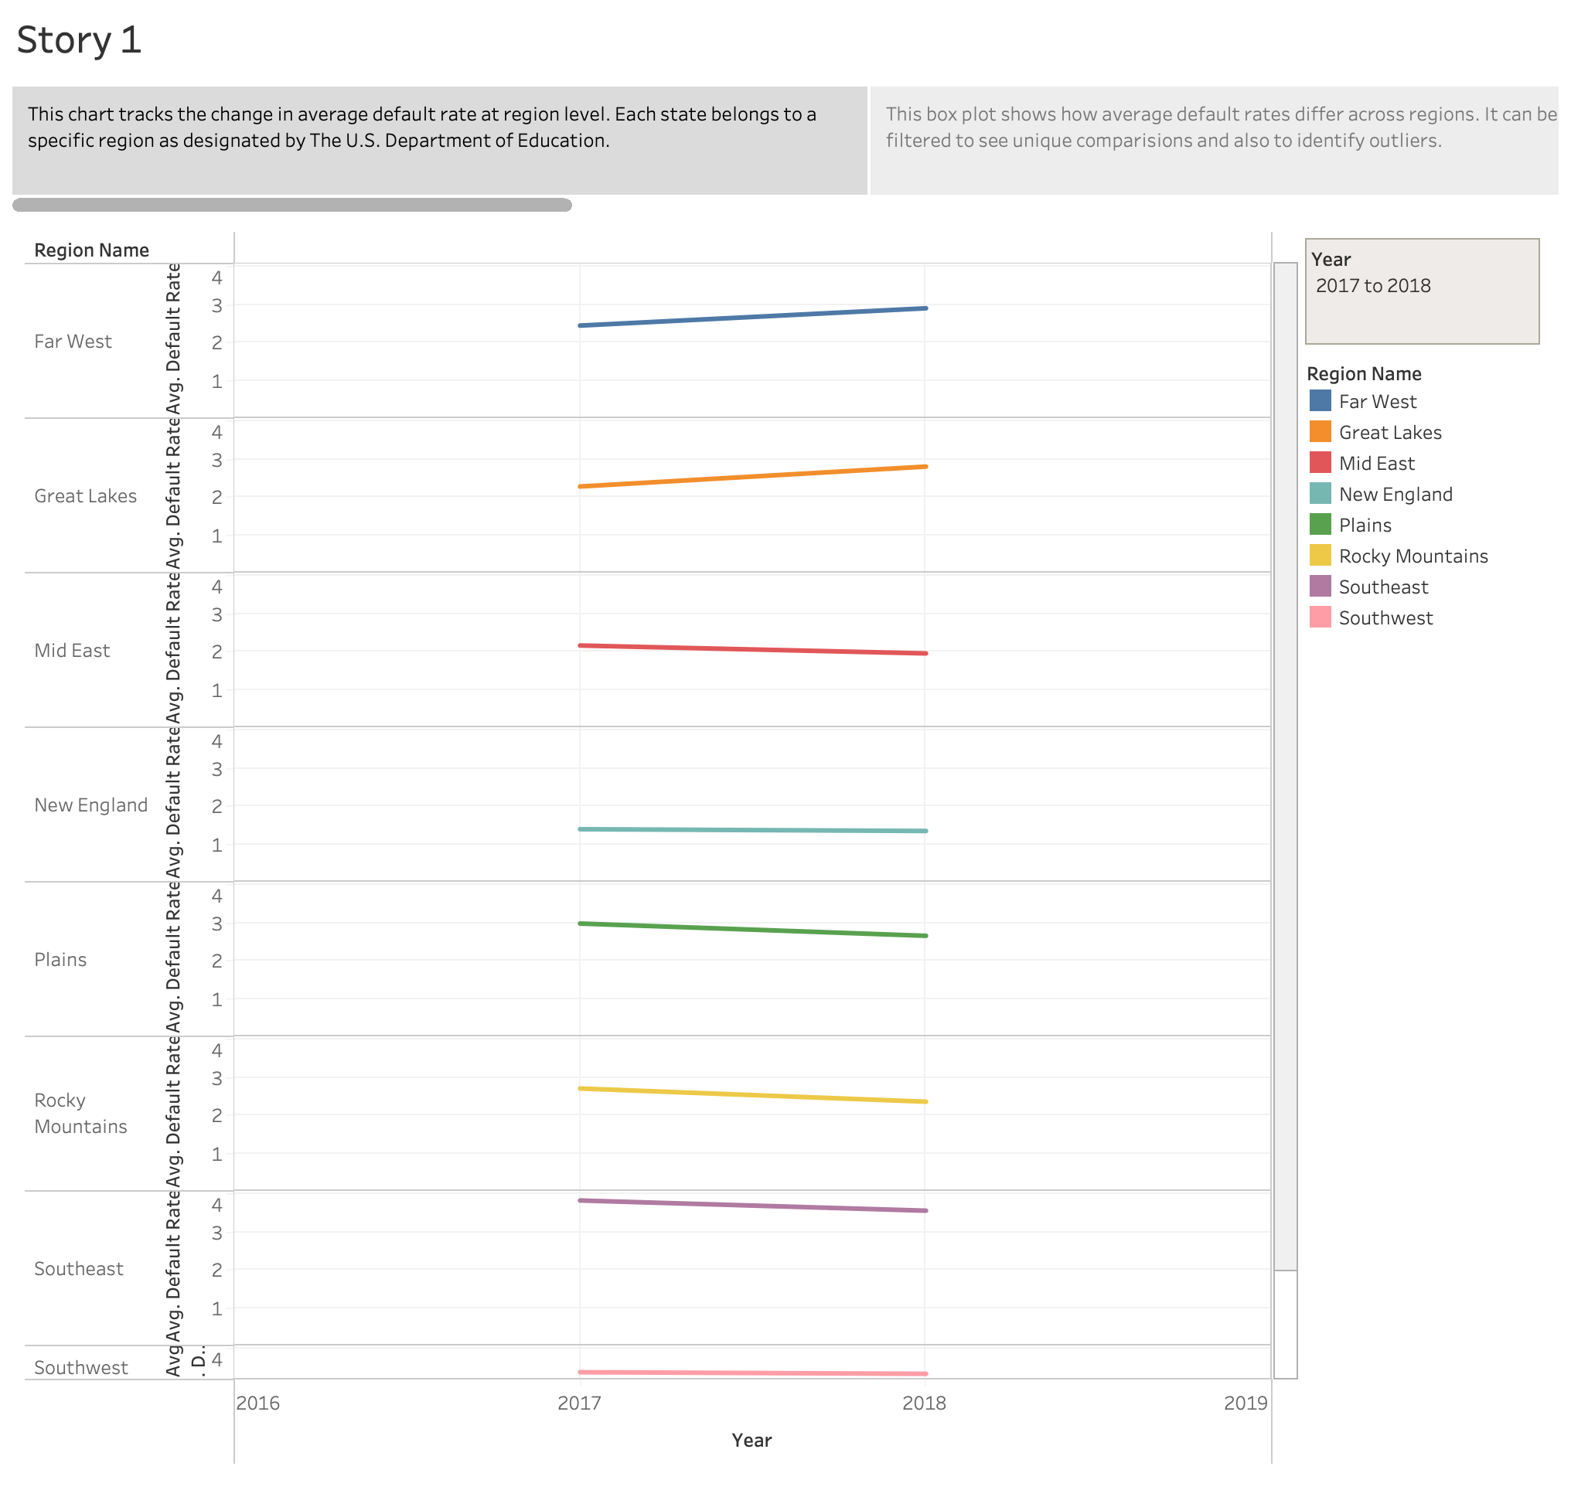

Slide 3
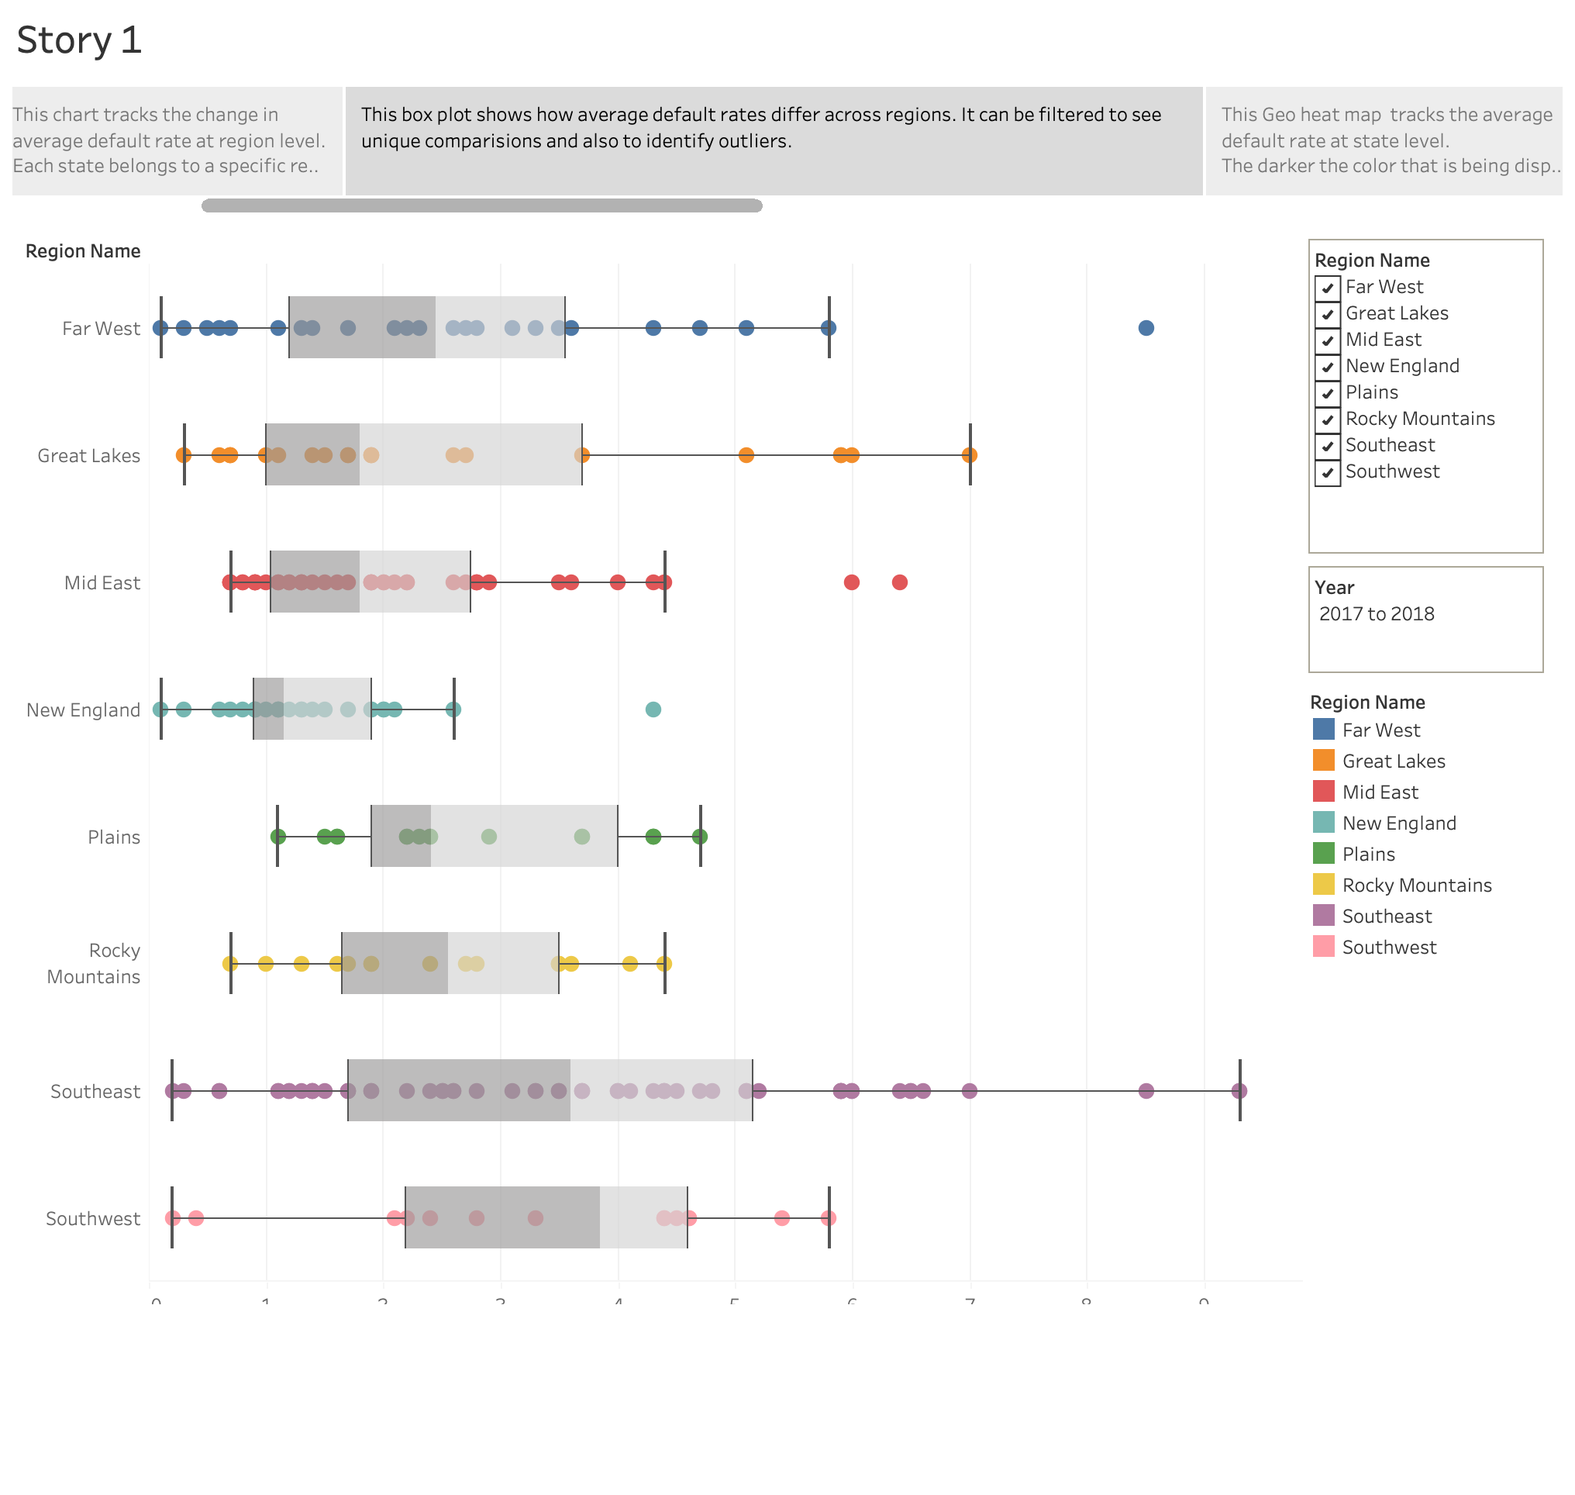

Slide 4
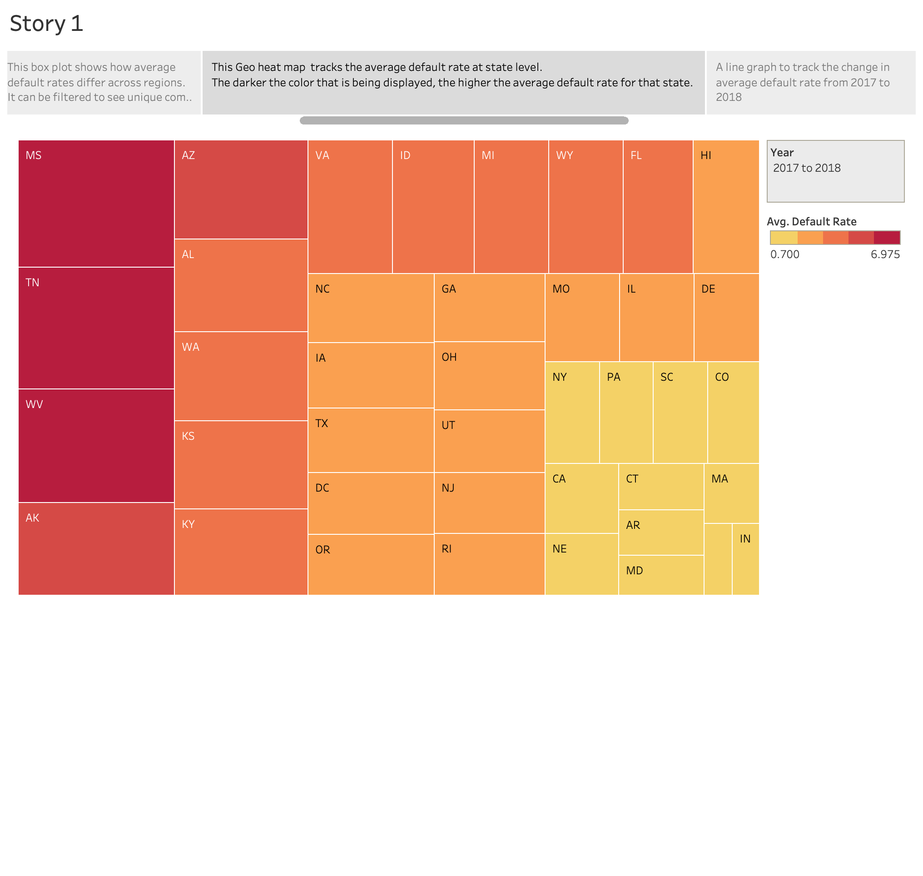

Slide 5
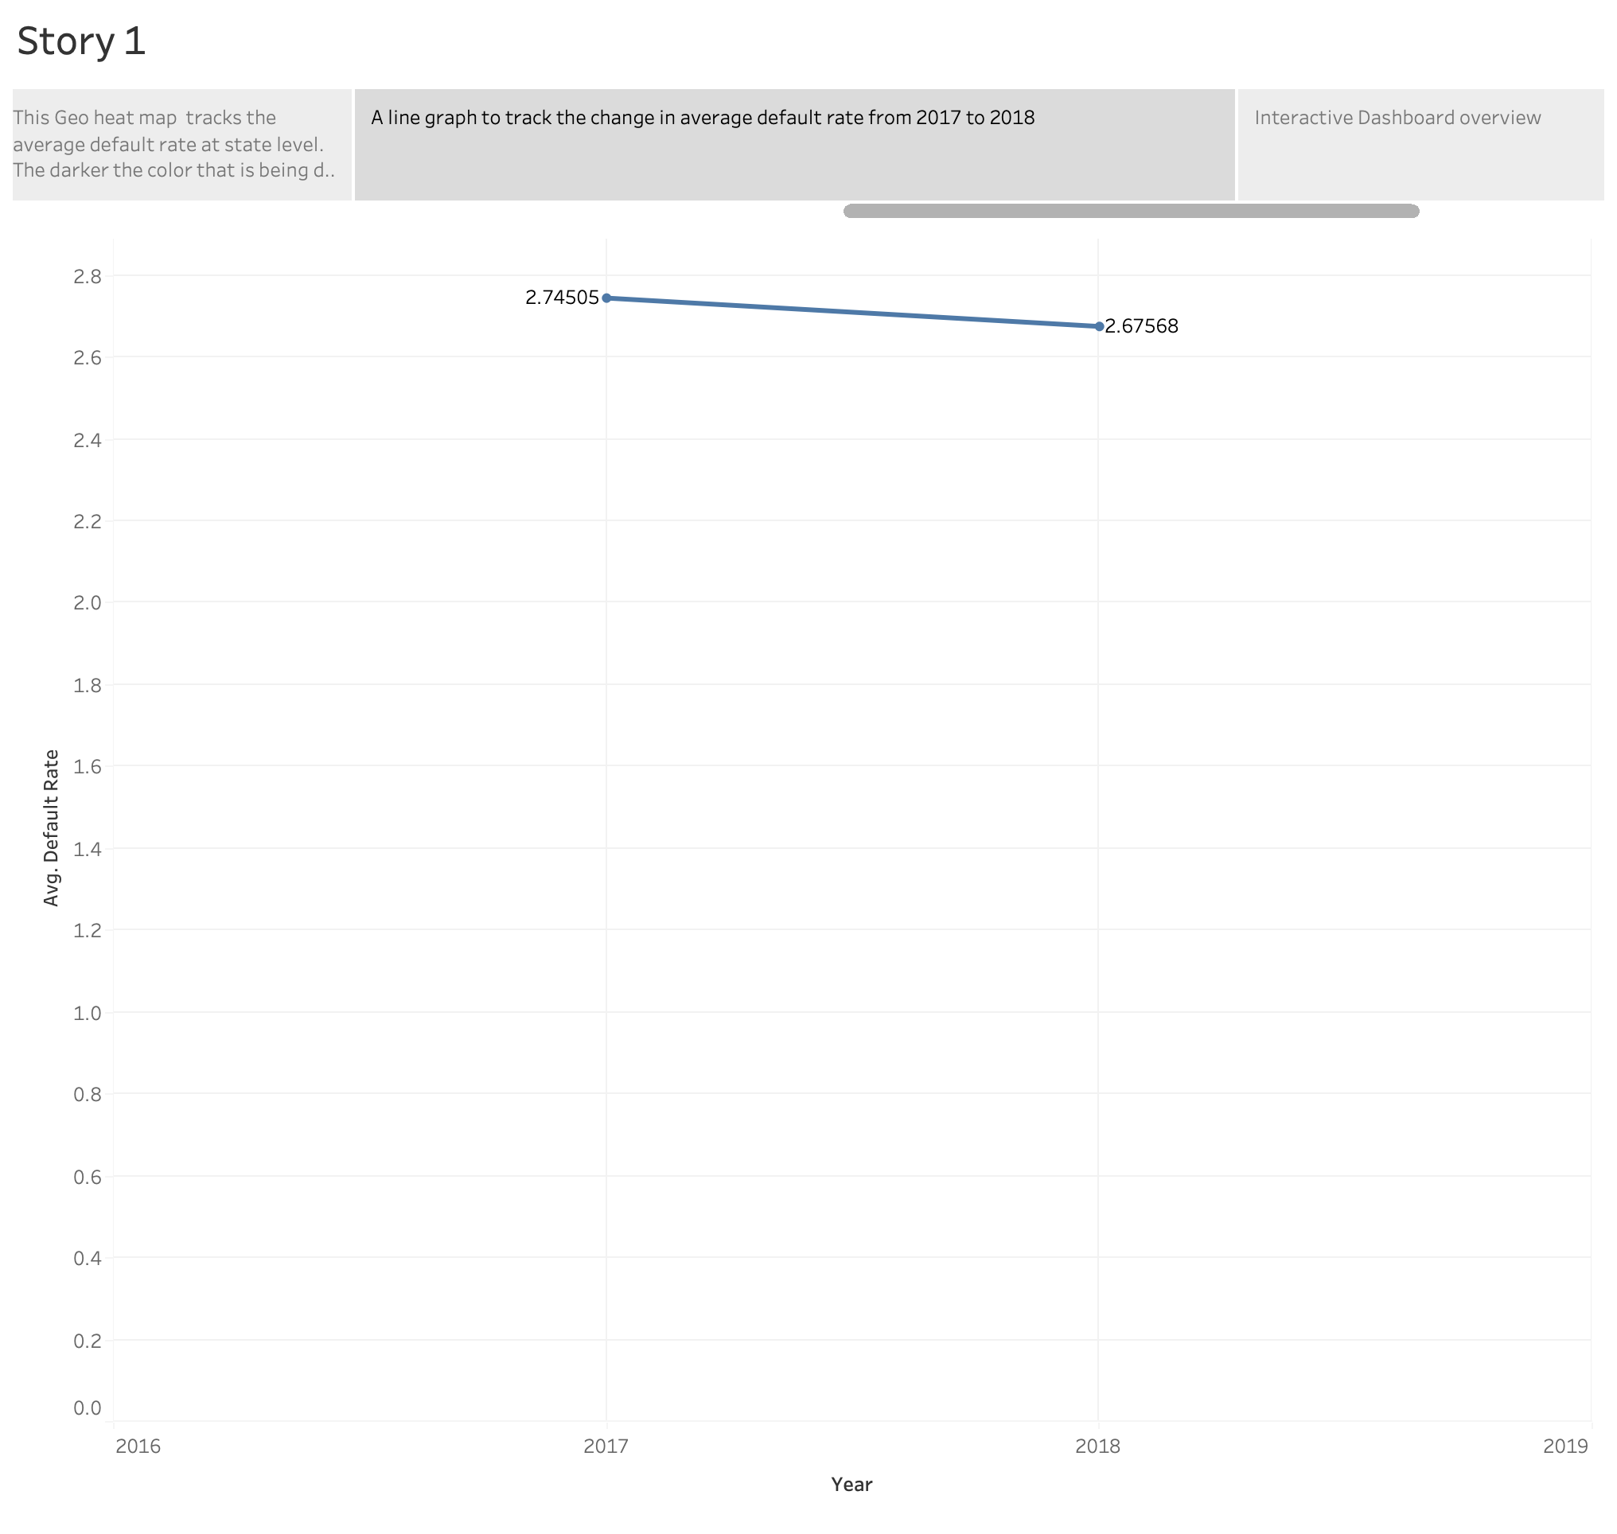

Slide 6
